Slide 1
Story at Initialization
Bingrui Li
2024.01.05

Slide 2
Outline
1. Background
2. Main results
3. Technical part
Disclaimer
1. The talk is non-exhaustive compared with extensive theoretical and empirical results in the literature. For example, see App.A in (Hayou & Yang, 2023). I only talk about some of them :)
2. The talk is possibly unfriendly for online audience, sorry about that

Slide 3
Outline
1. Background
initialization method in practice
potential implication for practitioners
2. Main results
3. Technical part

Slide 4
Background:
What is the scope of initialization?
What is the typical initialization method in practice?
Any empirical modification about initialization to improve performance, stabilize training process, and/or make training more efficient?
Any other roles?

Slide 5
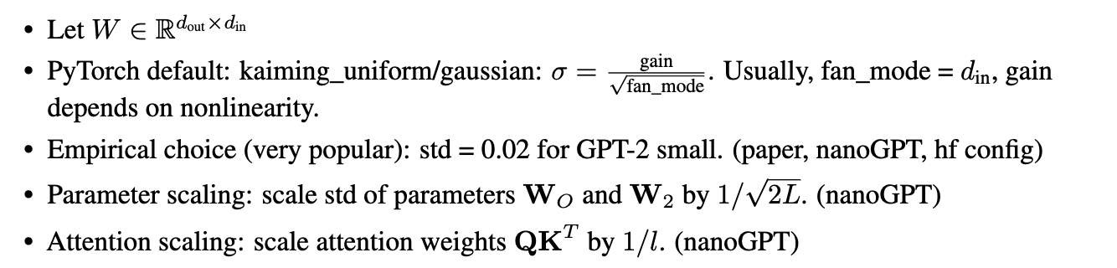
Informally(my definition): initialization contains initialization std, choice of nonlinearity, (non)learnable linear transformation (e.g., scalar multiplier, centering), even minor architecture modification, etc.
Some straightforward methods:
Other implications (more exciting):
simplifying architecture
scaling up
hyperparameter transfer

Slide 6
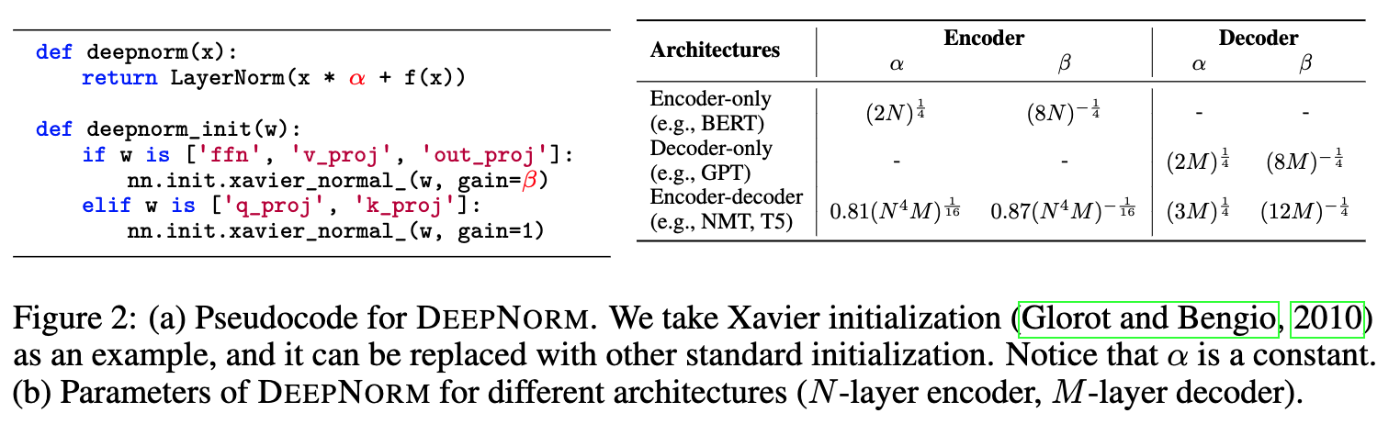
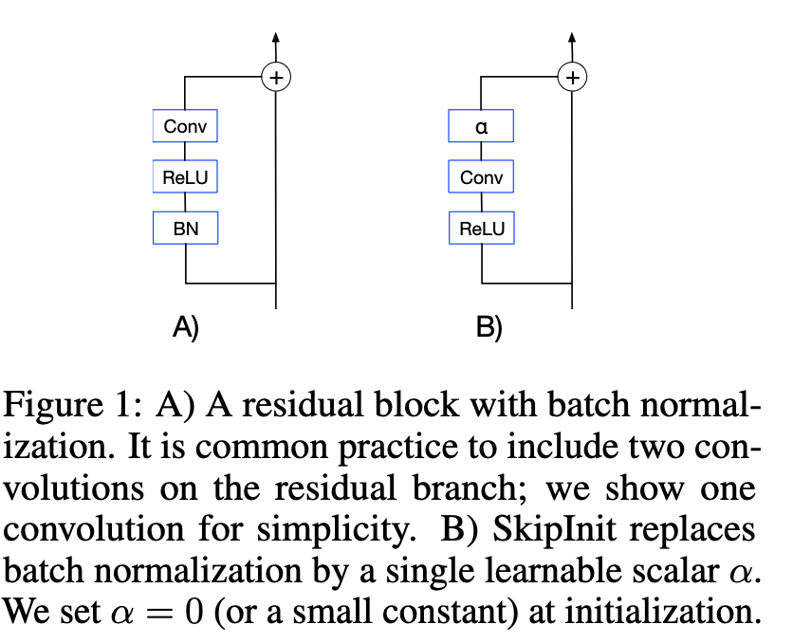
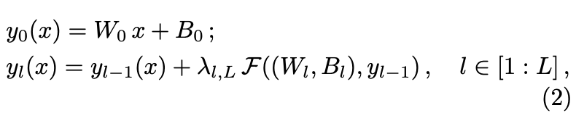
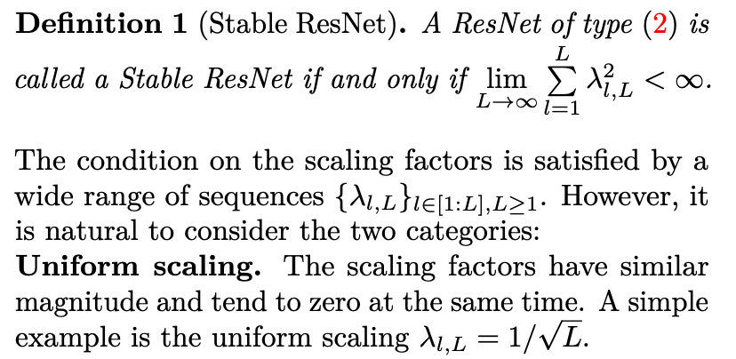
Downweighting the residual branch
DeepNorm (Wang et. al., 2022): Post-LN
SkipInit (De & Smith, 2020)
Pre-BN
Stable ResNet (Hayou et. al., 2021)

Slide 7
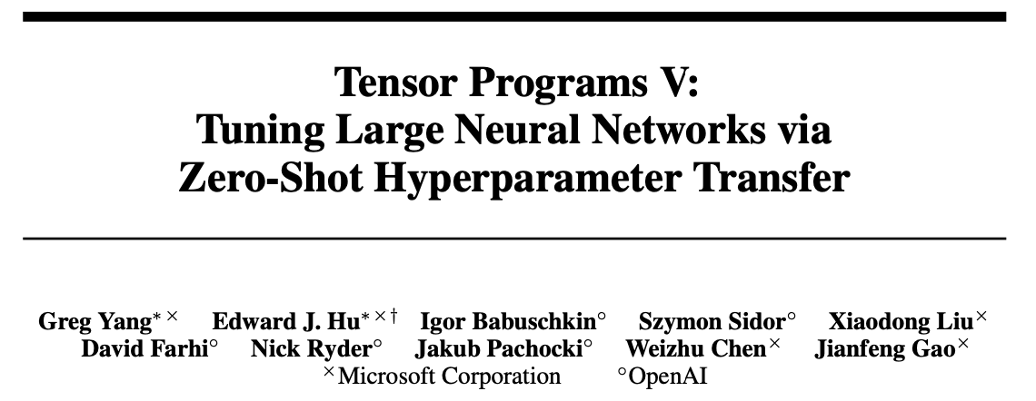
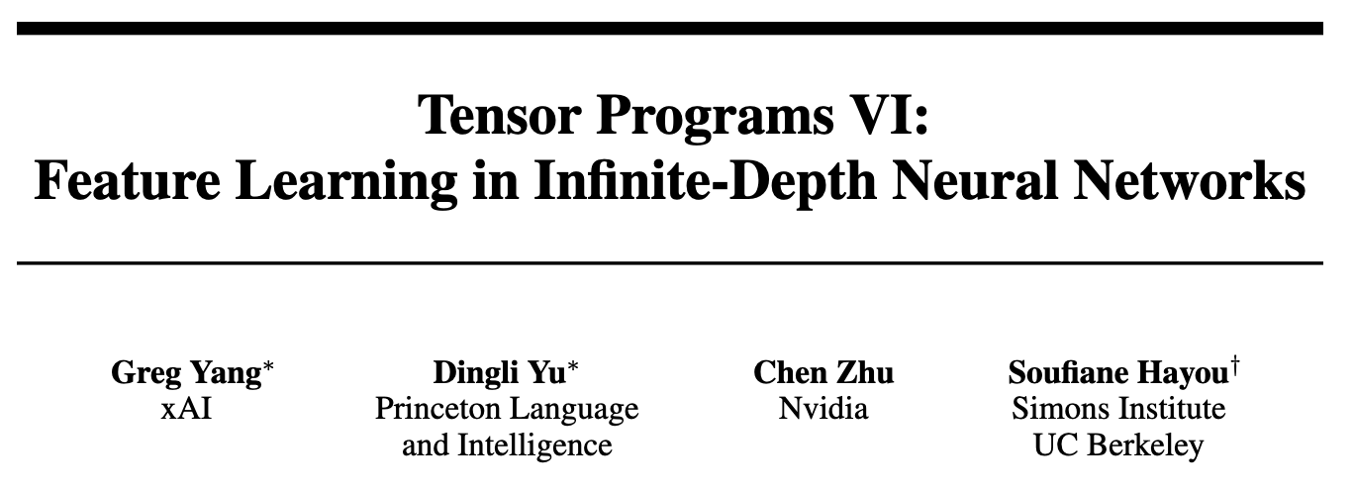
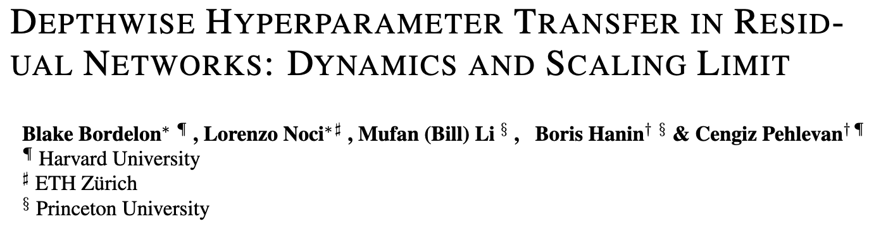
Hyperparameter transfer

Slide 8
Outline
1. Background
2. Main results
what do we care about ? – pre-activation distribution & neural covariance
case on wide feed forward neural networks (MLP)
case on wide and deep feed forward neural networks
case on wide and deep residual networks
3. Technical part

Slide 9
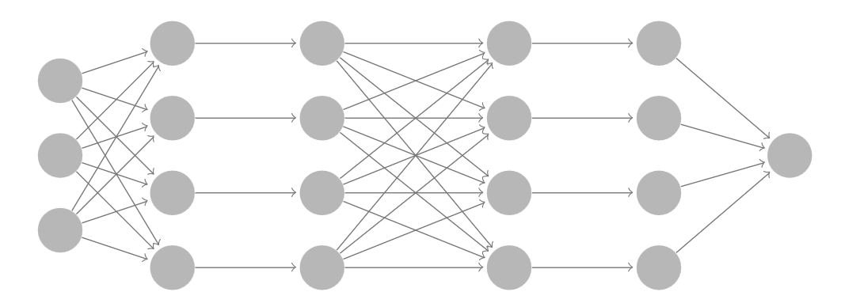
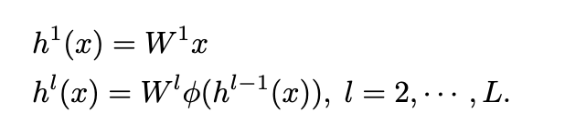
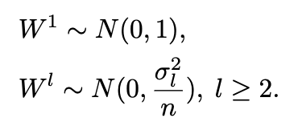
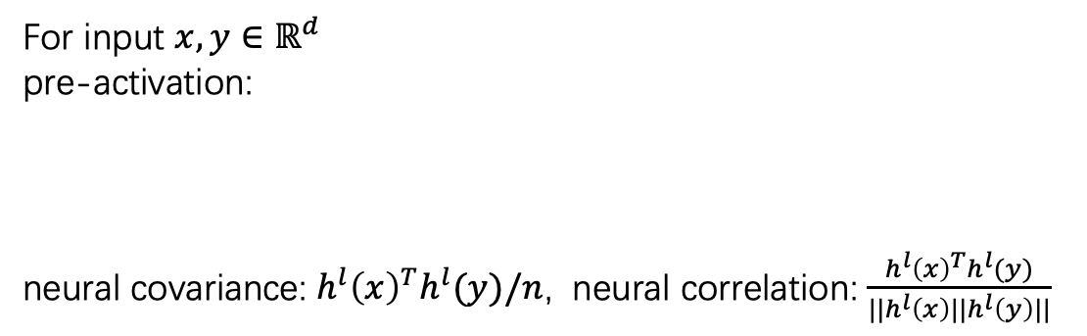
Model
pre-activation 1
activation 1
pre-activation 2
activation 2
Input
Output
For input $x, y∈ℝ^{d}$
pre-activation:
neural covariance: $h^{l}{\left(x\right)}^{T}h^{l}(y)/n$, neural correlation: ${\frac{h^{l}{\left(x\right)}^{T}h^{l}(y)}{{||h}^{l}\left(x\right){||h}^{l}\left(y\right)||}}^{}$
What are the distribution of the pre-activations in the large width and/or large depth limit?
What is limit of neural covariance when $l$ comes to infinity?

Slide 10
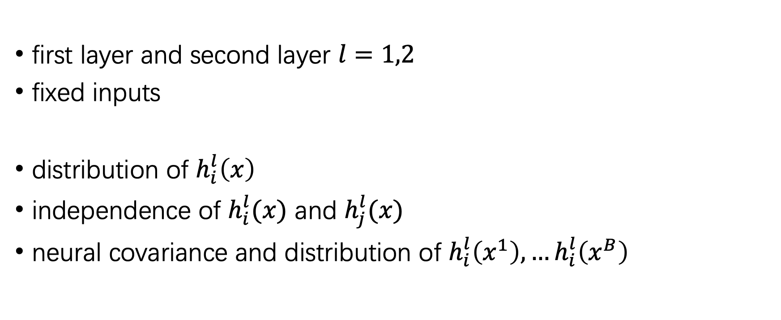
Heuristics: Wide MLP
first layer and second layer $l=1,2$
fixed inputs
distribution of $h_{i}^{l}\left(x\right)$
independence of $h_{i}^{l}(x)$ and $h_{j}^{l}(x)$
neural covariance and distribution of $h_{i}^{l}\left(x^{1}\right), …h_{i}^{l}\left(x^{B}\right)$

Slide 11
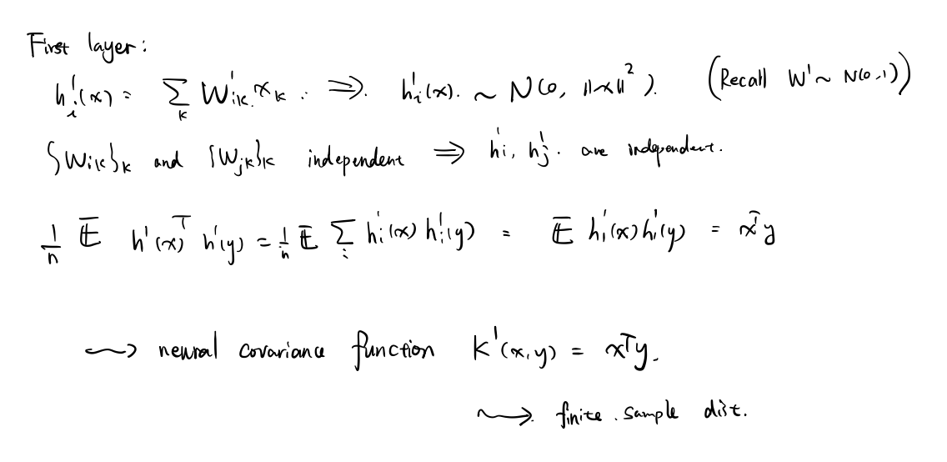
Heuristics: Wide MLP

Slide 12
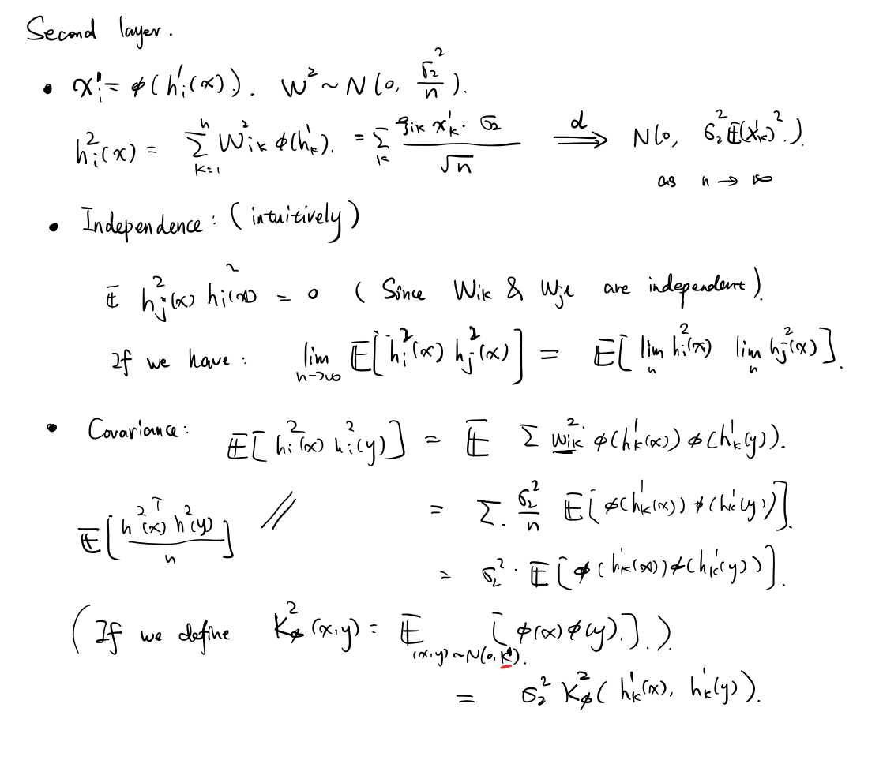
Heuristics: Wide MLP

Slide 13
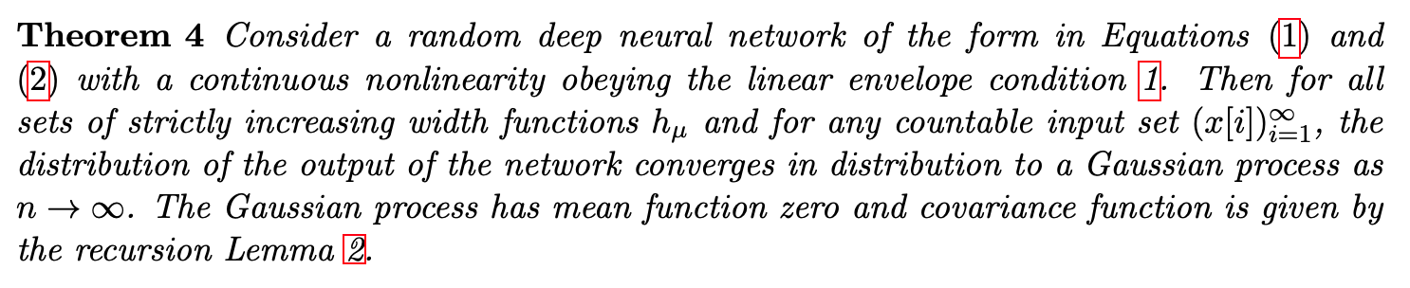
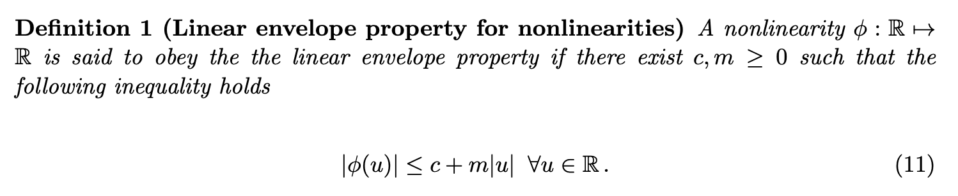
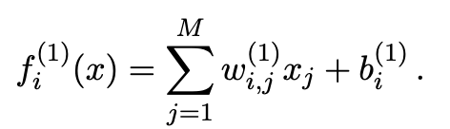
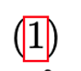
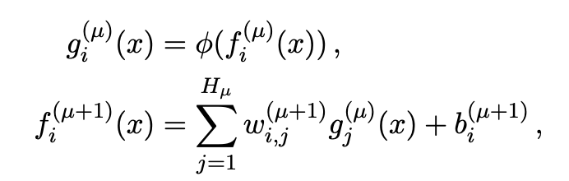
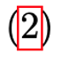
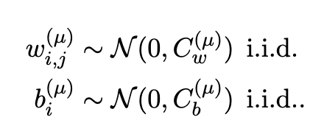
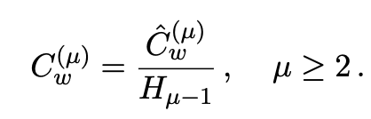
Wide MLP formal results (Matthews et. al., 2018)

Slide 14
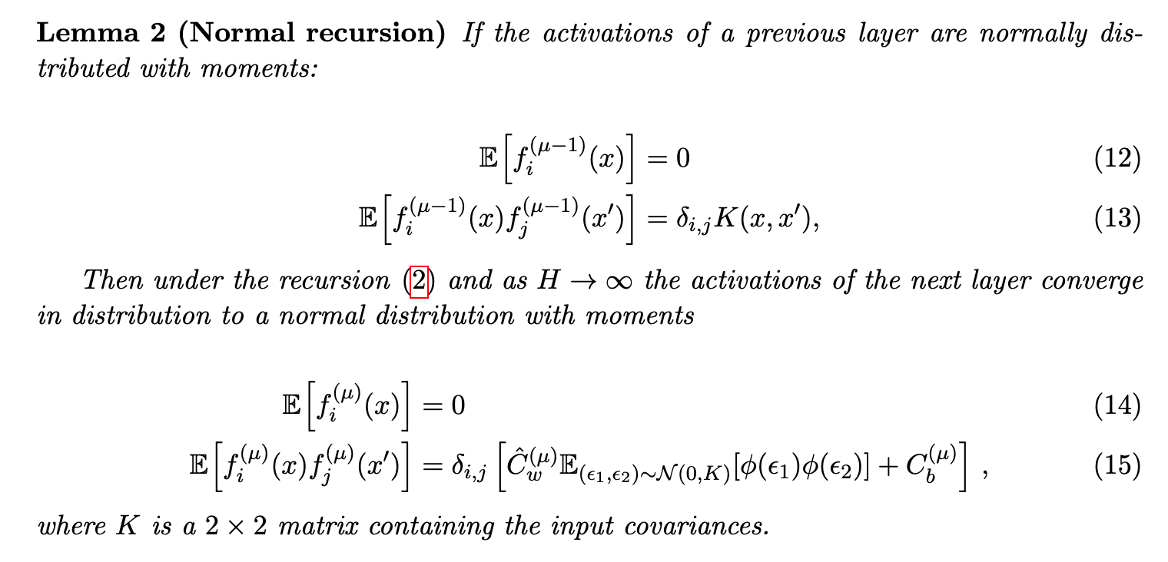

Slide 15
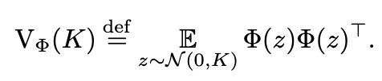
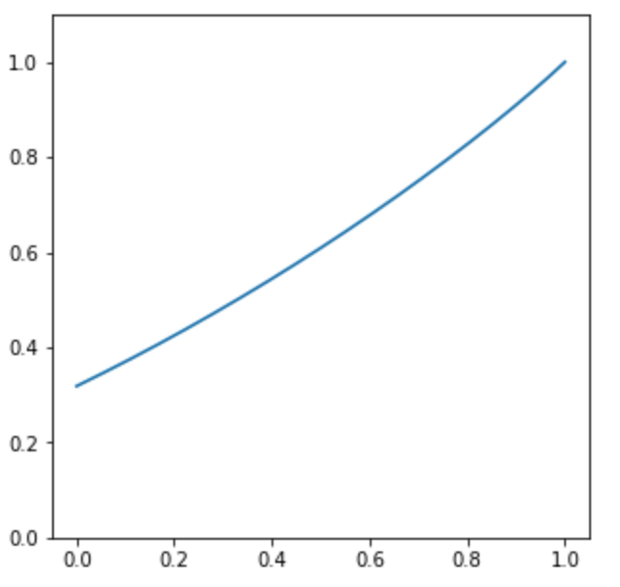
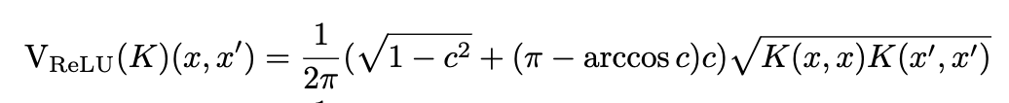
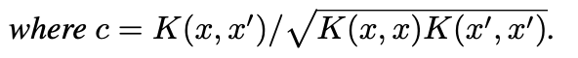
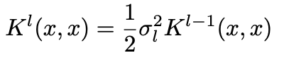
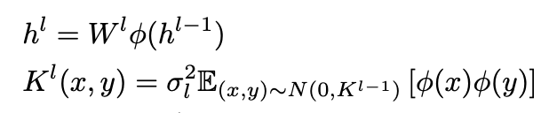
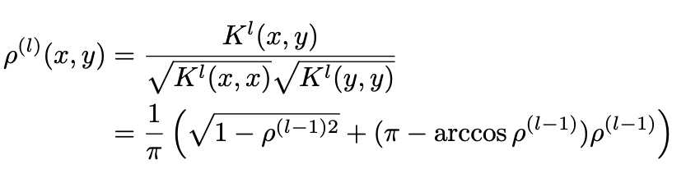
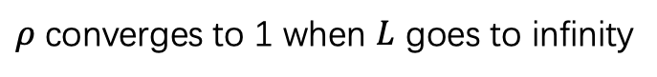
Neural cov./corr. at large depth: case for ReLU
Recall
$ρ$ converges to 1 when $L$ goes to infinity

Slide 16
Takeaway 1: when width goes to infinity first
distribution of pre-activations are gaussian
for single data point, different neurons at the same layer are independent
for finite number of data points, the join distribution of the neuron at the same position is gaussian, the covariance function is dependent to weight init std, and nonlinearity
we can compute the neural covariance/correlation exactly (at each layer). Neural correlation for any pair data converges to 1 as depth increases.

Slide 17
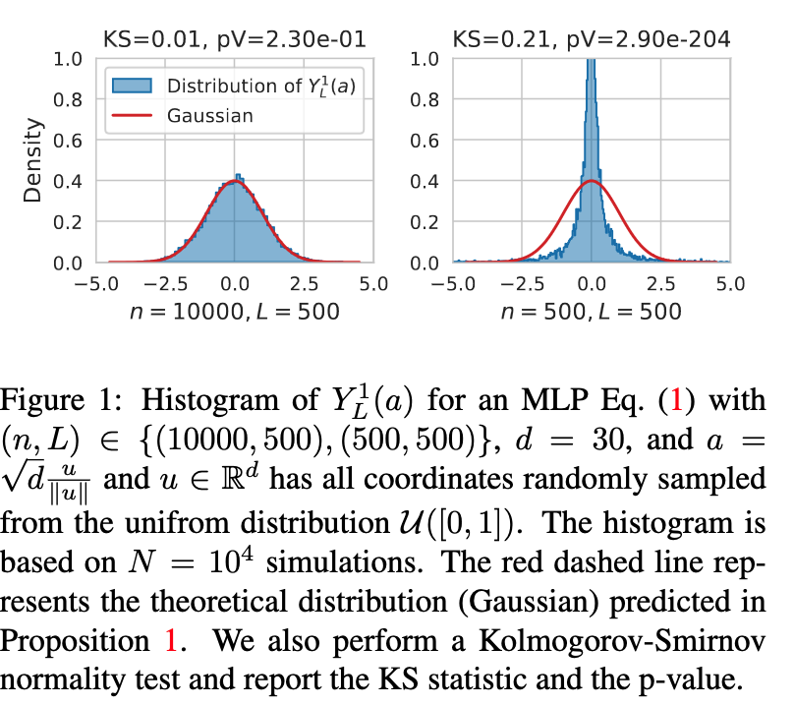
When n, L go to infinity simultaneously
For ReLU MLP:
1. distribution is not gaussian when the width is of the same magnitude as the depth (Li et al., 2021; Hayou and Yang, 2023)

Slide 18
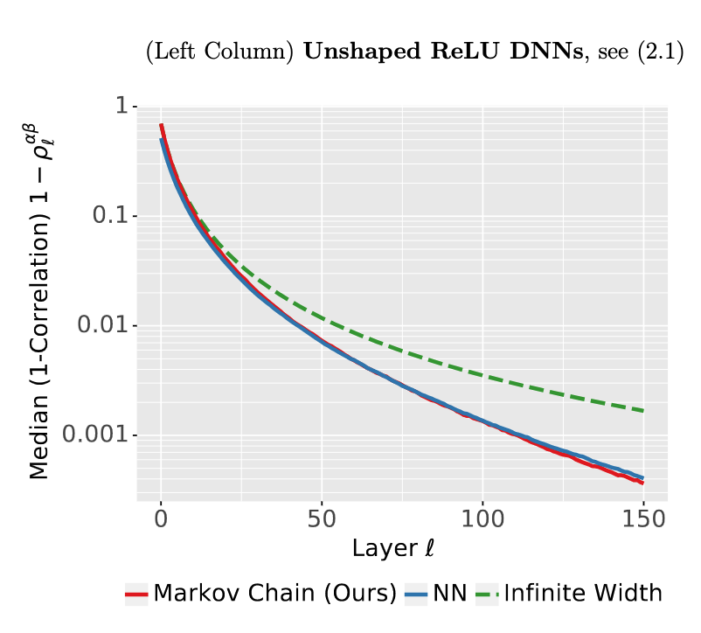
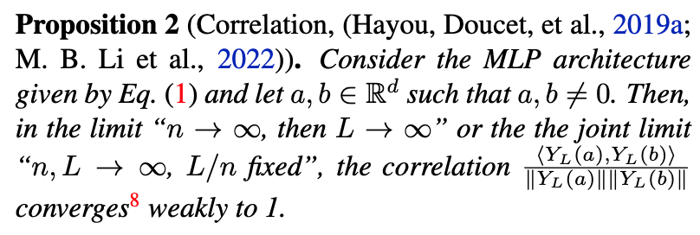
When n, L go to infinity simultaneously
For ReLU MLP:
2. correlation converges to 1
For MLP, width and depth limit cannot not commute (same behavior under different limits)
Fig 1. Left Top in (Li et al., 2022)

Slide 19
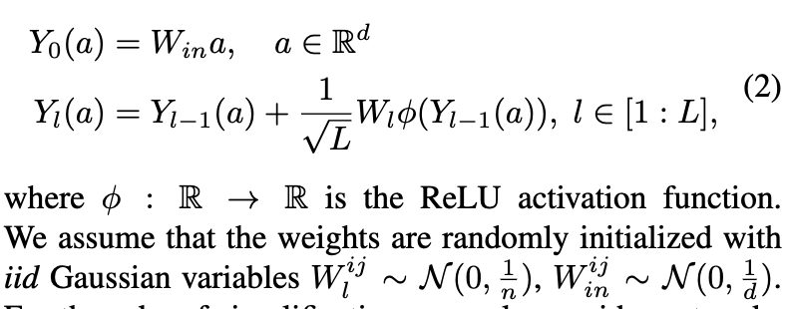
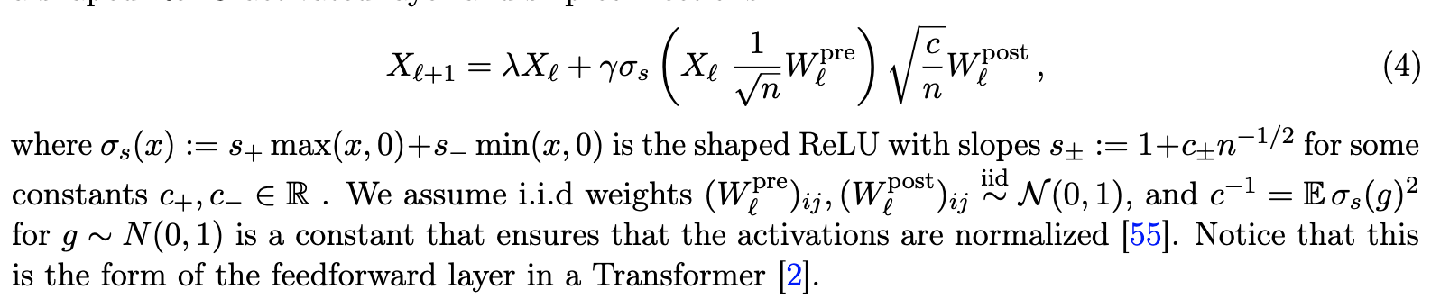
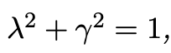
For residual networks
Consider two special cases:
Setting difference:
nonlinearity: ReLU v.s. Shaped ReLU
scaling factor
(Hayou and Yang, 2023)
Commutative
(Noci et al., 2023) with
Non-Commutative

Slide 20
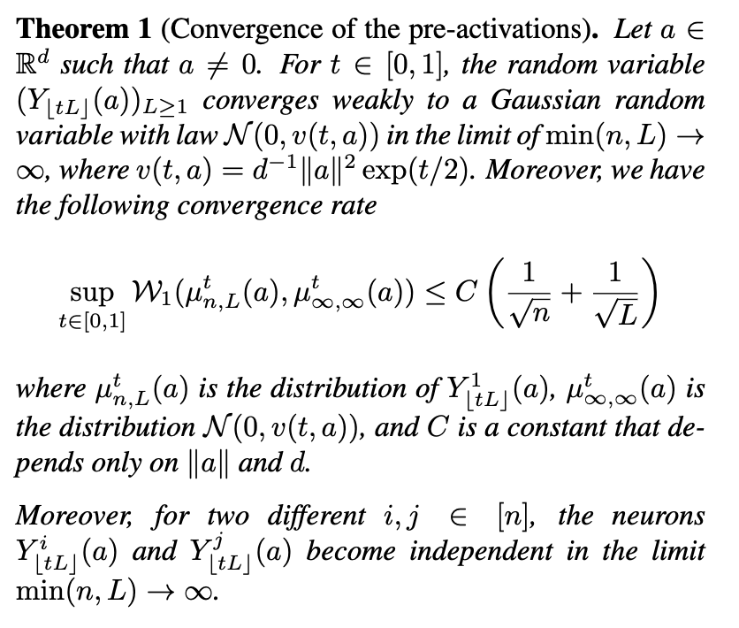
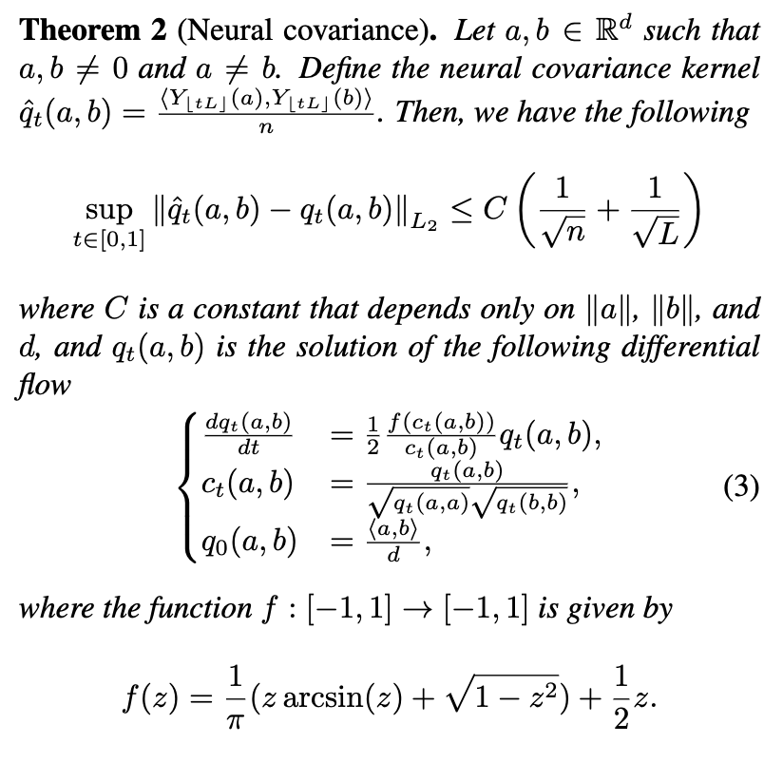
Option 1 (deterministic & commutative limit)
(Hayou and Yang, 2023)

Slide 21
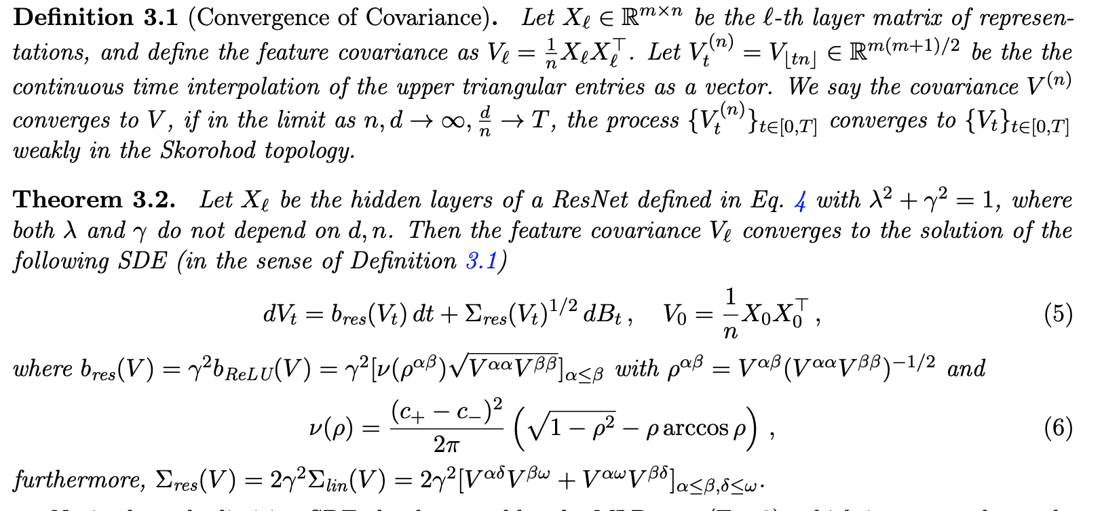
Option 2 (stochastic and non-commutative limit)
(Noci et al., 2023)

Slide 22
Takeaway 2: when n, L go to infinity together
For ReLU MLP, the width and depth limits do not commute in the sense that the behavior of the distribution of the pre-activations and the covariance structure might differ depending on how the limit is taken.
While For ReLU residual network with a specific scaling factor, the width and depth limits do commute.
Change the nonlinearity and the scaling factor, the width and depth limits can become non-commutative and non-deterministic.

Slide 23
Outline
1. Background
2. Main results
3. Technical part
Tensor Program I: Gaussian Process Behavior for all standard architectures (Yang, 2019)

Slide 24
Netsor programs: definition
Netsor programs are straight-line programs, where each variable follows one of three types, G, H, or A (such variables are called G-vars, H-vars, and A-vars), and after input variables, new variables can be introduced by one of the rules MatMul, LinComb, Nonlin to be discussed shortly. G and H are vector types and A is a matrix type;
intuitively, G-vars should be thought of as vectors that are asymptotically Gaussian, H-vars are images of G-vars by coordinatewise nonlinearities, and A-vars are random matrices with iid Gaussian entries.
G is a subtype of H, so that x : G(n) implies x : H(n).

Slide 25
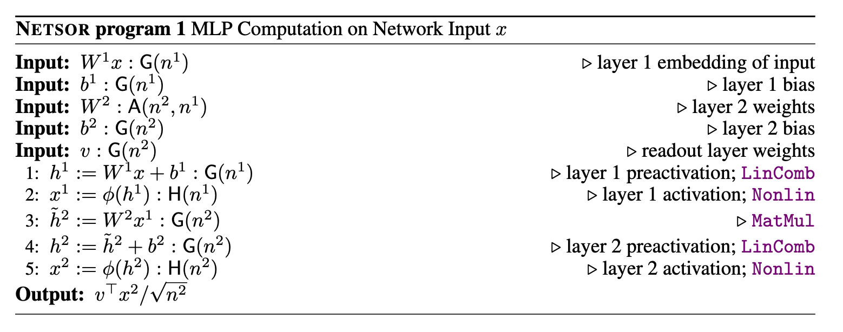
Netsor programs: example

Slide 26
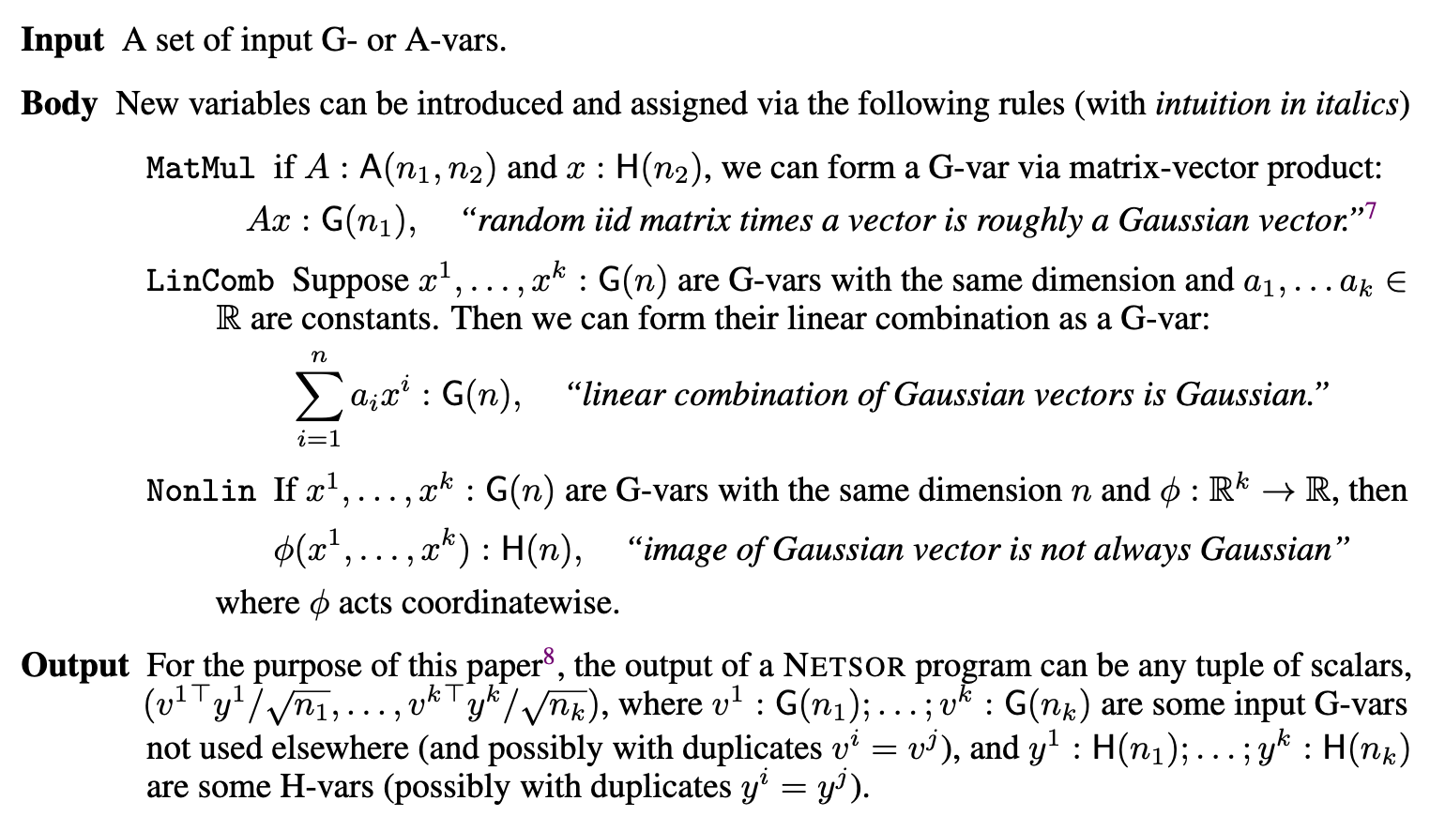

Slide 27
Netsor programs: example
What architectures can Netsor represent?
- For now, MLP, CNN, RNN, BatchNorm
- For Netsor+(with Nonlin+), LayerNorm, attention
- However, A and A^T cannot be used simultaneously

Slide 28
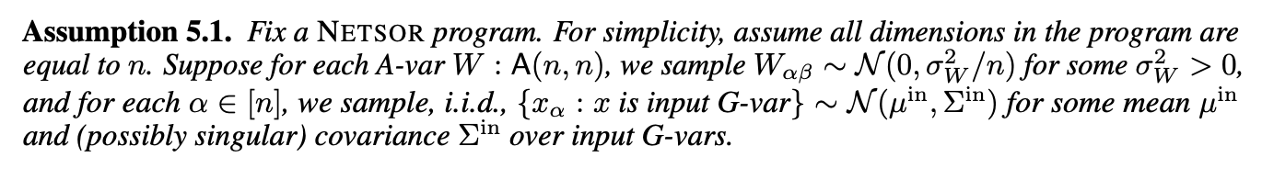
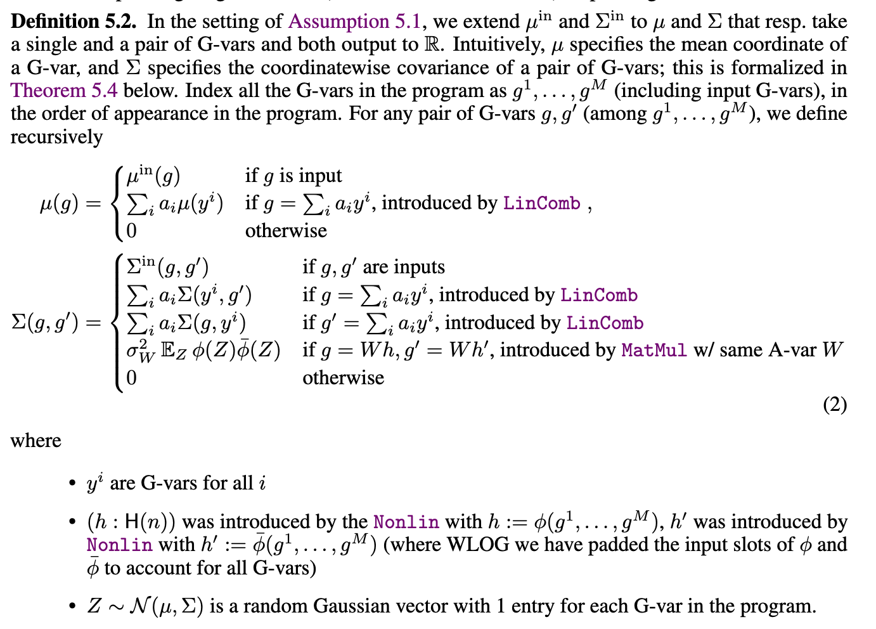
Master Theorem: Preparation

Slide 29
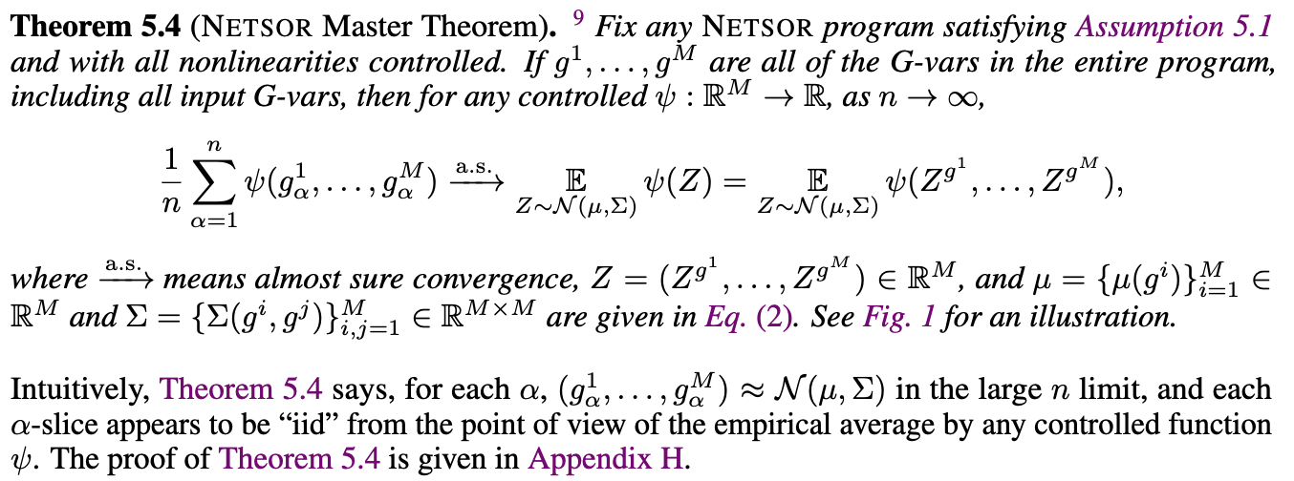
Master Theorem!
Master Theorem can help us compute not only neural covariance, but also inner product of any pair of G-vars.

Slide 30
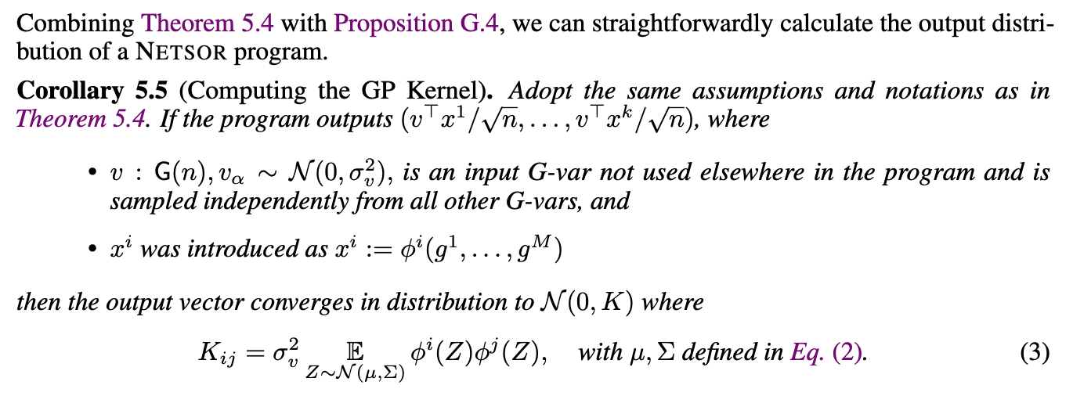
Gaussian Process Behavior

Slide 31
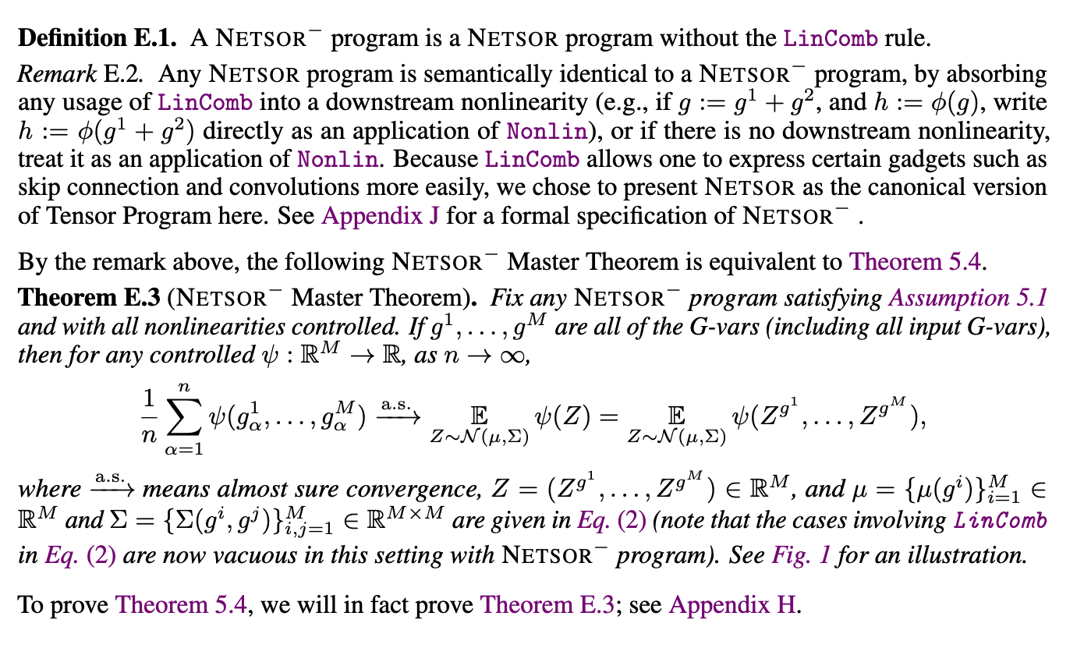
Proof of Master Theorem: Alternative

Slide 32
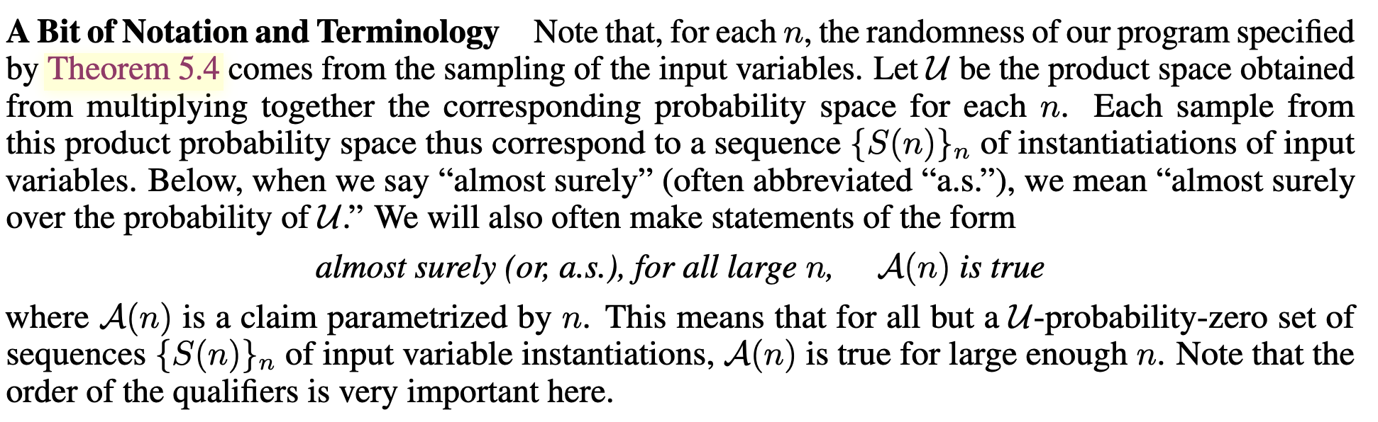
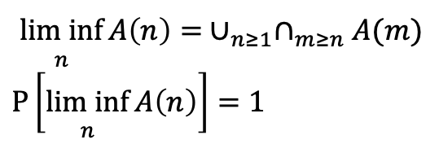
Proof Sketch
0. Notation
1. For input G-vars, statement is true
2. For variables introduced in the program, we prove by induction
$$\underset{n}{lim inf}{A\left(n\right)= ∪_{n≥1}∩_{m≥n}A(m)}$$
$$Ρ\left[\underset{n}{lim inf}{A\left(n\right)}\right]=1$$

Slide 33

Proof Sketch
0. Notation
1. For input G-vars, statement is true
2. For variables introduced in the program, we prove by induction
Basis is to identify the minimal linearly independent {g^i}. And note n depends on \omega.
NullAvoid is for independence, roughly.The n depends on the zero measure set, so there is possibly not any n such that {g} has density

Slide 34

Proof Sketch
0. Notation
1. For input G-vars, statement is true
2. For variables introduced in the program, we prove by induction

Slide 35


Base Case: Moment(input vars)
Generally, SLLN for triangular array does not hold
But since nonlinearity is polynomial-bounded, it has finite moments. We can prove ES_n <= Cn^2, and by Borel-Cantelli lemma, we have

Slide 36






Inductive Case: setup
Suppose Moments(m-1) and CoreSet(m-1) holds.
Suppose we have g = Ah, we want to characterize the distribution of g conditioned on g^1, ... g^{m-1}
Memory \hat{g}!
Finally, we have
where
Now we want to study the large n limit of \omega and \sigma

Slide 37




Inductive Case: setup
Now we want to study the large n limit of \omega and \sigma
Define
Recall
By Moments(m-1), we have
And we have
Some calculation for proof
Why this holds?

Slide 38


Setup: Rank & Zero Stability

Slide 39



Setup: Zero Stability
We want to represent a function of (Z_1, ..., Z_{m-1}) with a function of Z|_\mathcal{M}
NullAvoid is useful from finite lebesgue measure to original tough measure

Slide 40

Setup: Rank Stability
Then we have

Slide 41







CoreSet(m): If $\dot{σ}=0$
We will show that the core set properties are maintained if we don’t add m to the core set. => only need to show Basis(m)
How to show Basis(m): Note g = Ah, h = \phi(g^1, ..., g^{m-1}), we want to show h can be represented by {\hat{h}^i} a.s. for large n
=> study the nonlinearity \phi and \hat{\phi}^i
Recall

Slide 42

CoreSet(m): If $\dot{σ}=0$
By NullAvoid(m-1), we step from a.s. under Z|M to a.s. under original probability space

Slide 43




CoreSet(m): If $\dot{σ}>0$
We will add g to the core set.
The Basis(m) naturally holds. For NullAvoid(m):
tools of measure theory needed for rigor

Slide 44


Moments(m)
If $\dot{σ}=0$, Moments(m) trivially holds by Basis(m). Now we consider $\dot{σ}>0.$

Slide 45



C -> 0

Slide 46




A -> 0
We prove this by bounding moments of A, by Borel-Contelli Lemma

Slide 47

A -> 0
Note that
We only need to show last term of RHS at last line is bounded in n.
Skip

Slide 48


B -> 0
Basically, we prove this by showing the function is continuous w.r.t. w_\alpha and \sigma, then w -> \ring{w} implies B -> 0.
Below is for w_\alpha. we have similar argument for \sigma.
Q.E.D :)

Slide 49
Main reference
Matthews, A. G. D. G., Rowland, M., Hron, J., Turner, R. E., & Ghahramani, Z. (2018). Gaussian process behaviour in wide deep neural networks. arXiv preprint arXiv:1804.11271.
Hayou, S., & Yang, G. (2023). Width and Depth Limits Commute in Residual Networks. arXiv preprint arXiv:2302.00453.
Noci, L., Li, C., Li, M. B., He, B., Hofmann, T., Maddison, C., & Roy, D. M. (2023). The shaped transformer: Attention models in the infinite depth-and-width limit. arXiv preprint arXiv:2306.17759.
Yang, G. (2019). Tensor Programs I: Wide Feedforward or Recurrent Neural Networks of Any Architecture are Gaussian Processes. arXiv preprint arXiv:1910.12478.

